Slide 1

Software Engineering
Software Project Management, Architecture & Design
Software Design
Department of Computer Science and Engineering
Acknowledgement: Authors of the prescribed textbooks and materials sourced online.
‹#›

Slide 2

Software Design
List of Contents
Service Oriented Architecture (SOA)
Benefits of SOA
Services
Characteristics of Services
SOA Rules
Example : Openstack
Department of Computer Science and Engineering
‹#›
‹#›

Slide 3
Service Oriented Architecture (SOA)
Service-Oriented Architecture (SOA) is an architectural style that supports a way to make software components
reusable via service interfaces.
Each service in an SOA embodies the code and data integrations required to execute a complete, discrete
business function
The services are exposed using standard network protocols—such as SOAP (simple object access
protocol)/HTTP or JSON/HTTP—to send requests to read or change data
SOA can also be looked at as a software design methodology based on structured collections of discrete
software modules, known as services
SOAs origin comes from the concept of “separation of concerns” breaking down a large problem into a
series of smaller, individual problems or concerns

Slide 4
Benefits of SOA
Greater business agility; faster time to market
Ability to leverage legacy functionality in new markets
SOA enables developers to easily take functionality in one computing platform
Improved collaboration between business and IT
Service reusability

Slide 5
Services
What is a service?
• It is a logical representation of a repeatable business activity that has a specified outcome
(ex: check customer credit, provide weather data, consolidate drilling reports)
• These could be implemented as discrete pieces of software or components written in any
language capable of performing a task
• These could be implemented as “callable entities” or application functionalities accessed via exchange of messages
• These could also be application functionality with wrappers which can communicate
through messages

Slide 6
Characteristics of Services
Adhere to a service contract
Loosely coupled
Stateless
Autonomous
Abstraction
Reusable
Open standards
Facilitate interoperability
Can be discovered
Can be composed to form larger services

Slide 7
SOA Roles
Service provider
A service provider creates web services and provides them to a service registry
Service broker or service registry
A service broker or service registry is responsible for providing information about the service to a
requester
Service requester or service consumer
A service requester finds a service in a service broker or service registry and then will connect
with the service provider to receive the service

Slide 8
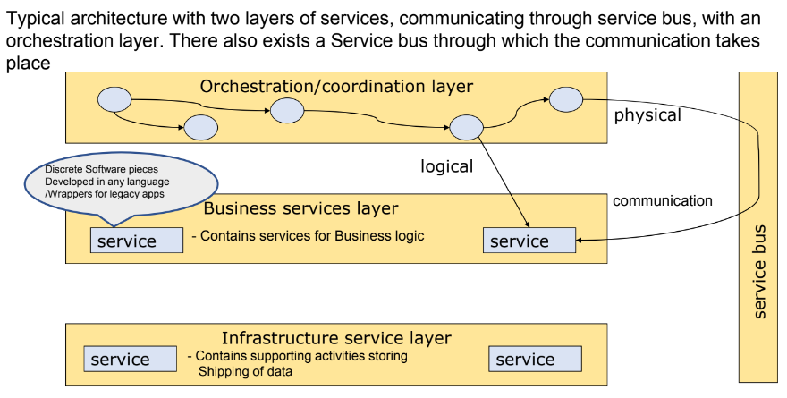
SOA

Slide 9
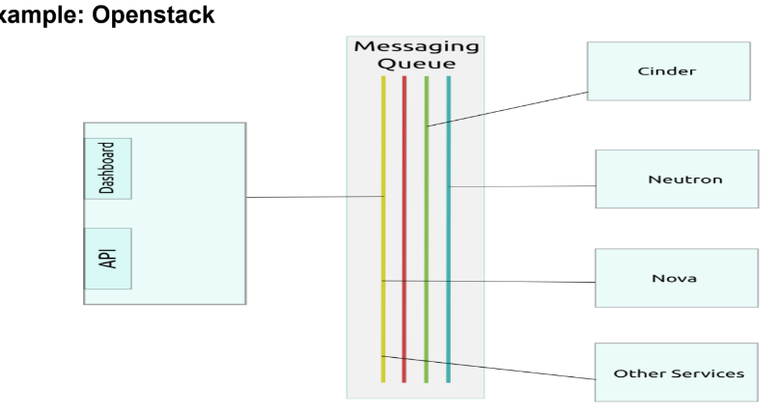
Example – Openstack

Slide 10
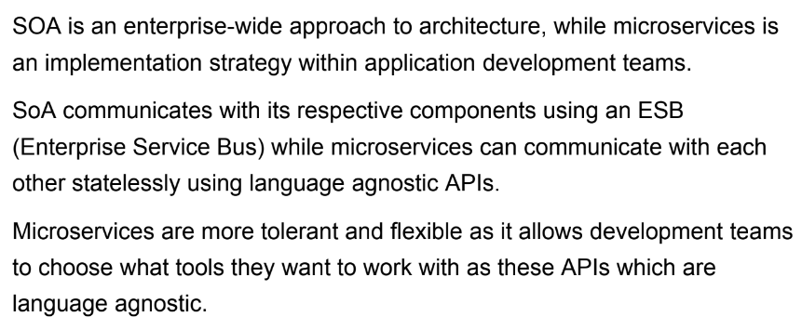
In – Class Exercise!
Draw a contrast between SOA & Microservice architecture

Slide 11
THANK YOU
Software Design
Department of Computer Science and Engineering
‹#›
‹#›

